Slide 1
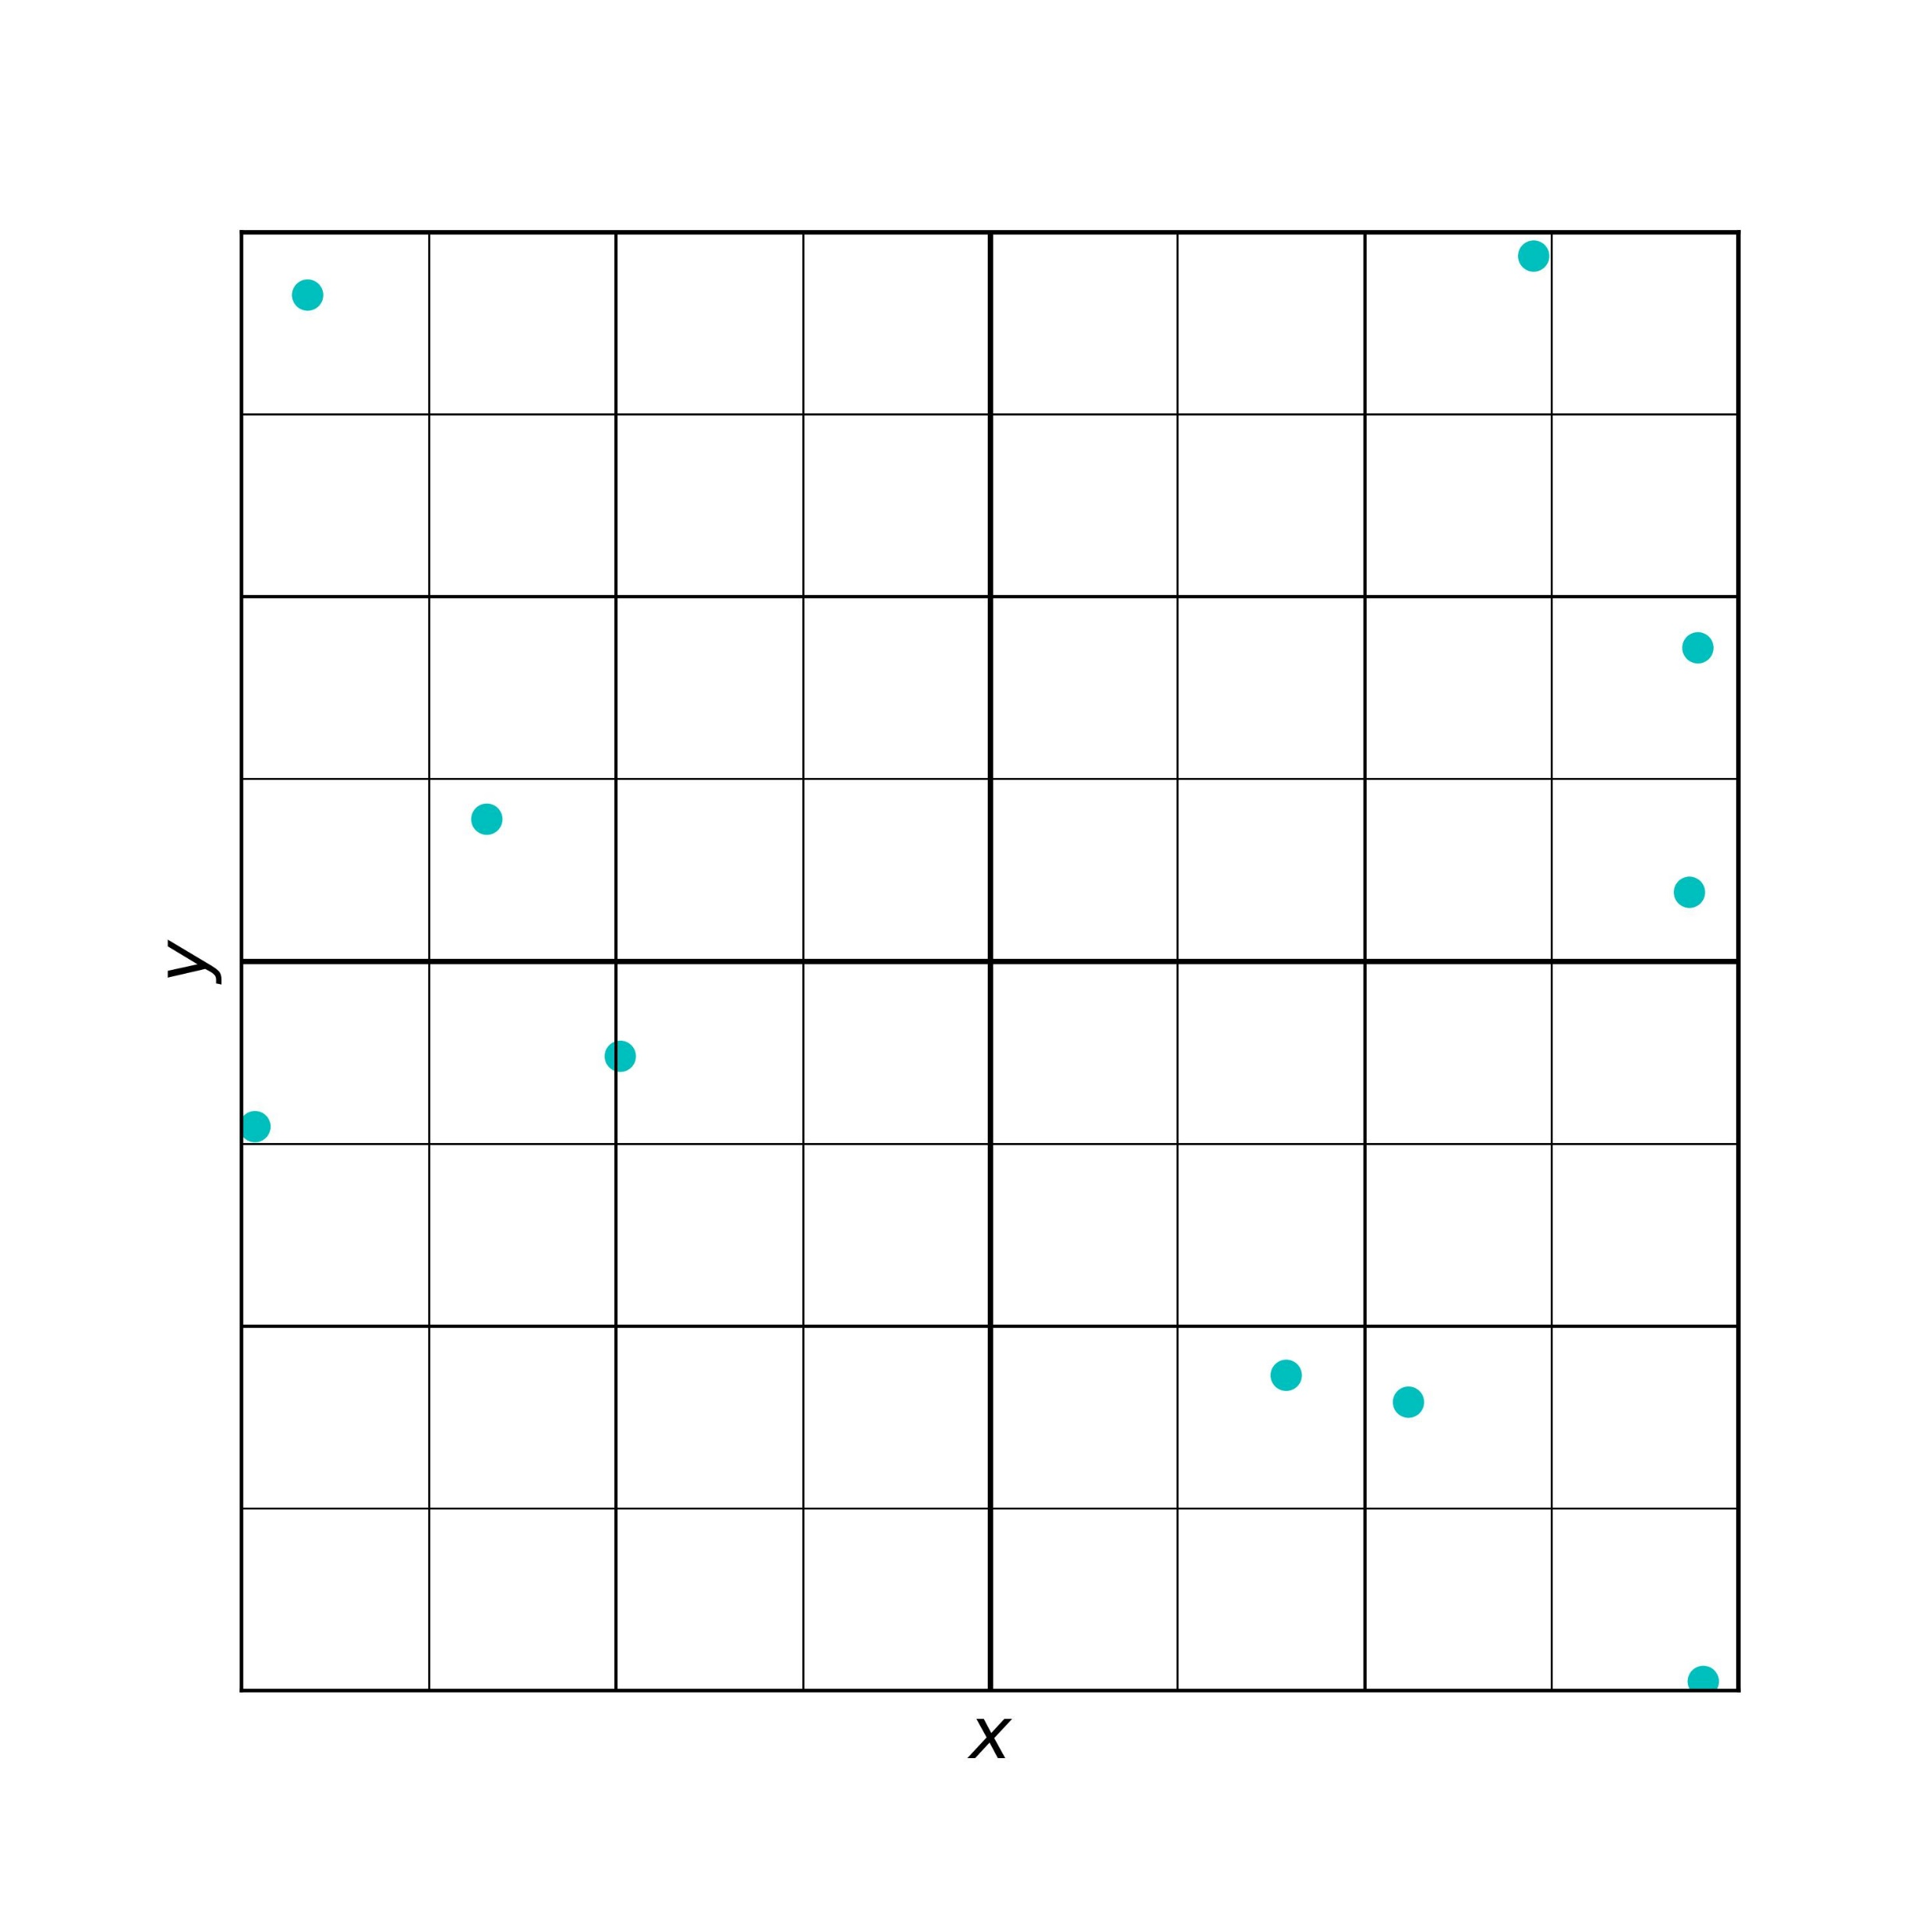

Slide 2
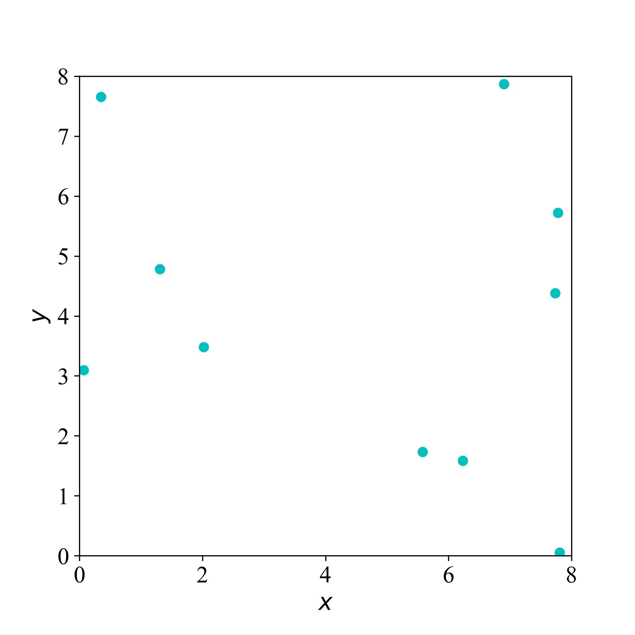

Slide 4
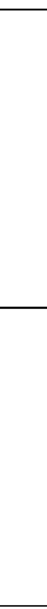

Slide 5


Slide 6


Slide 8
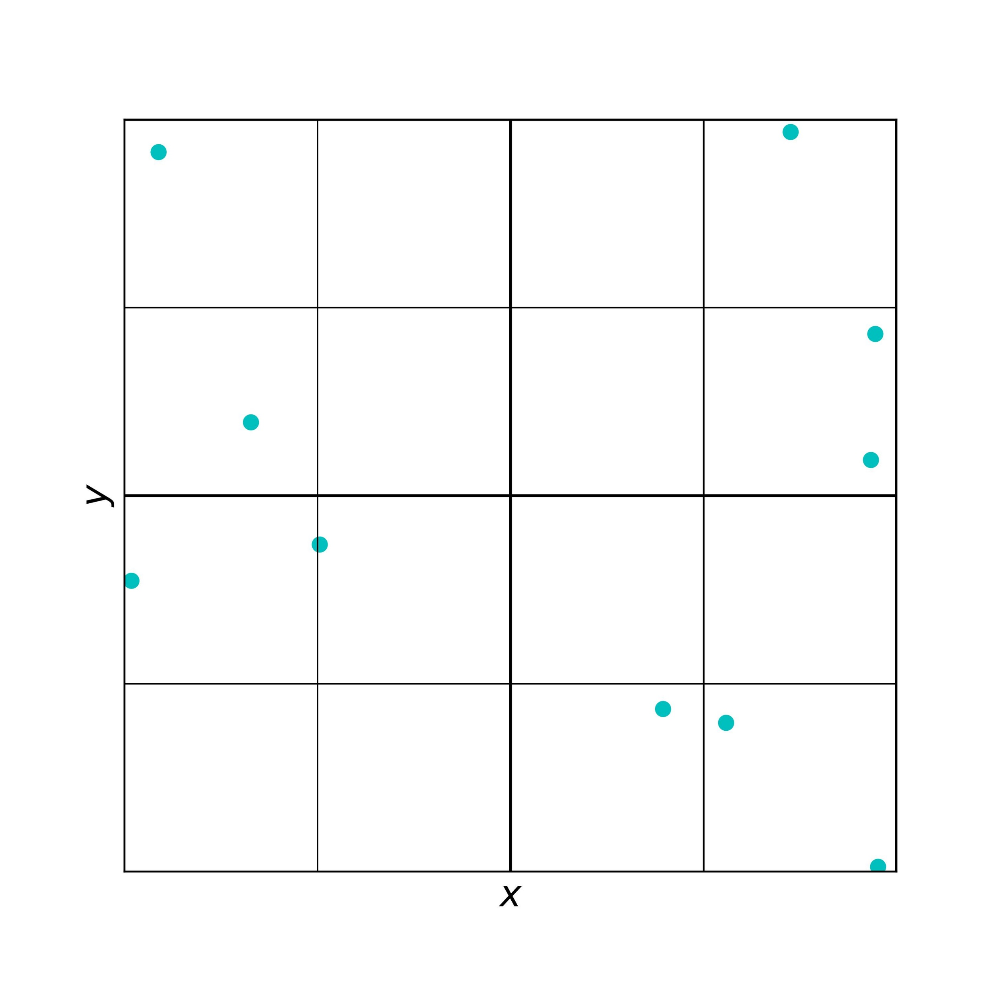

Slide 9


Slide 10

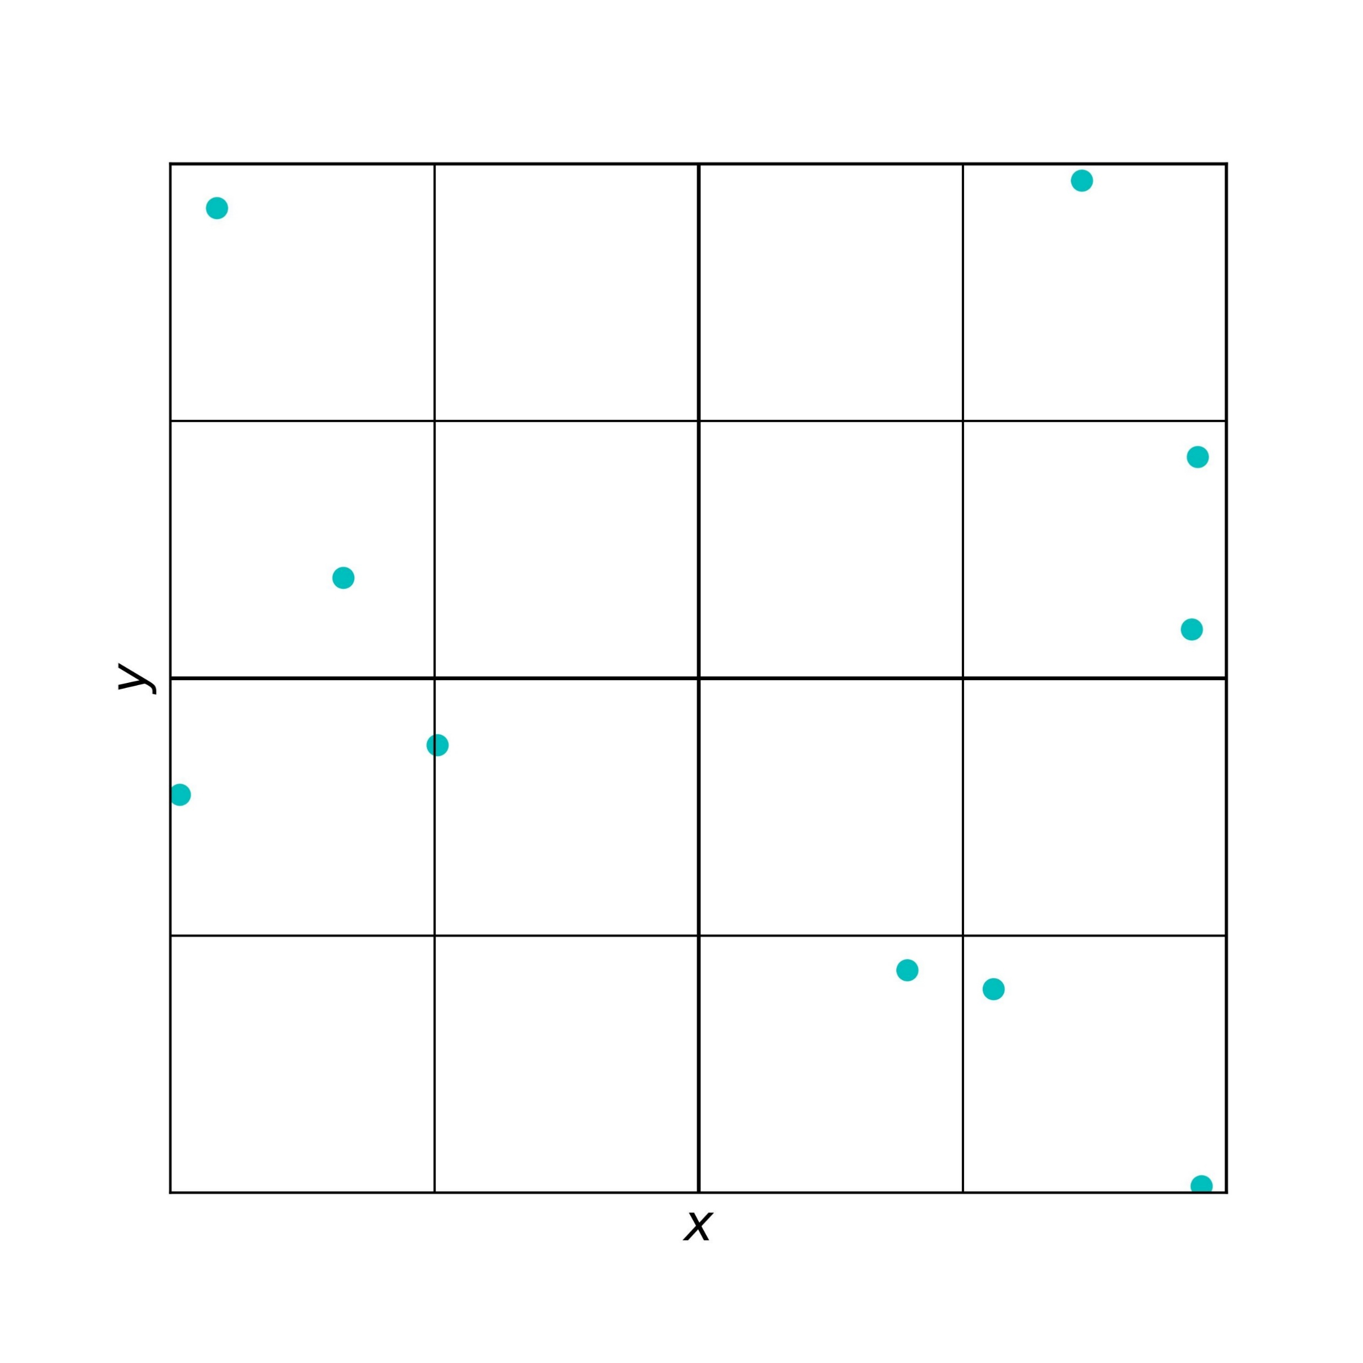
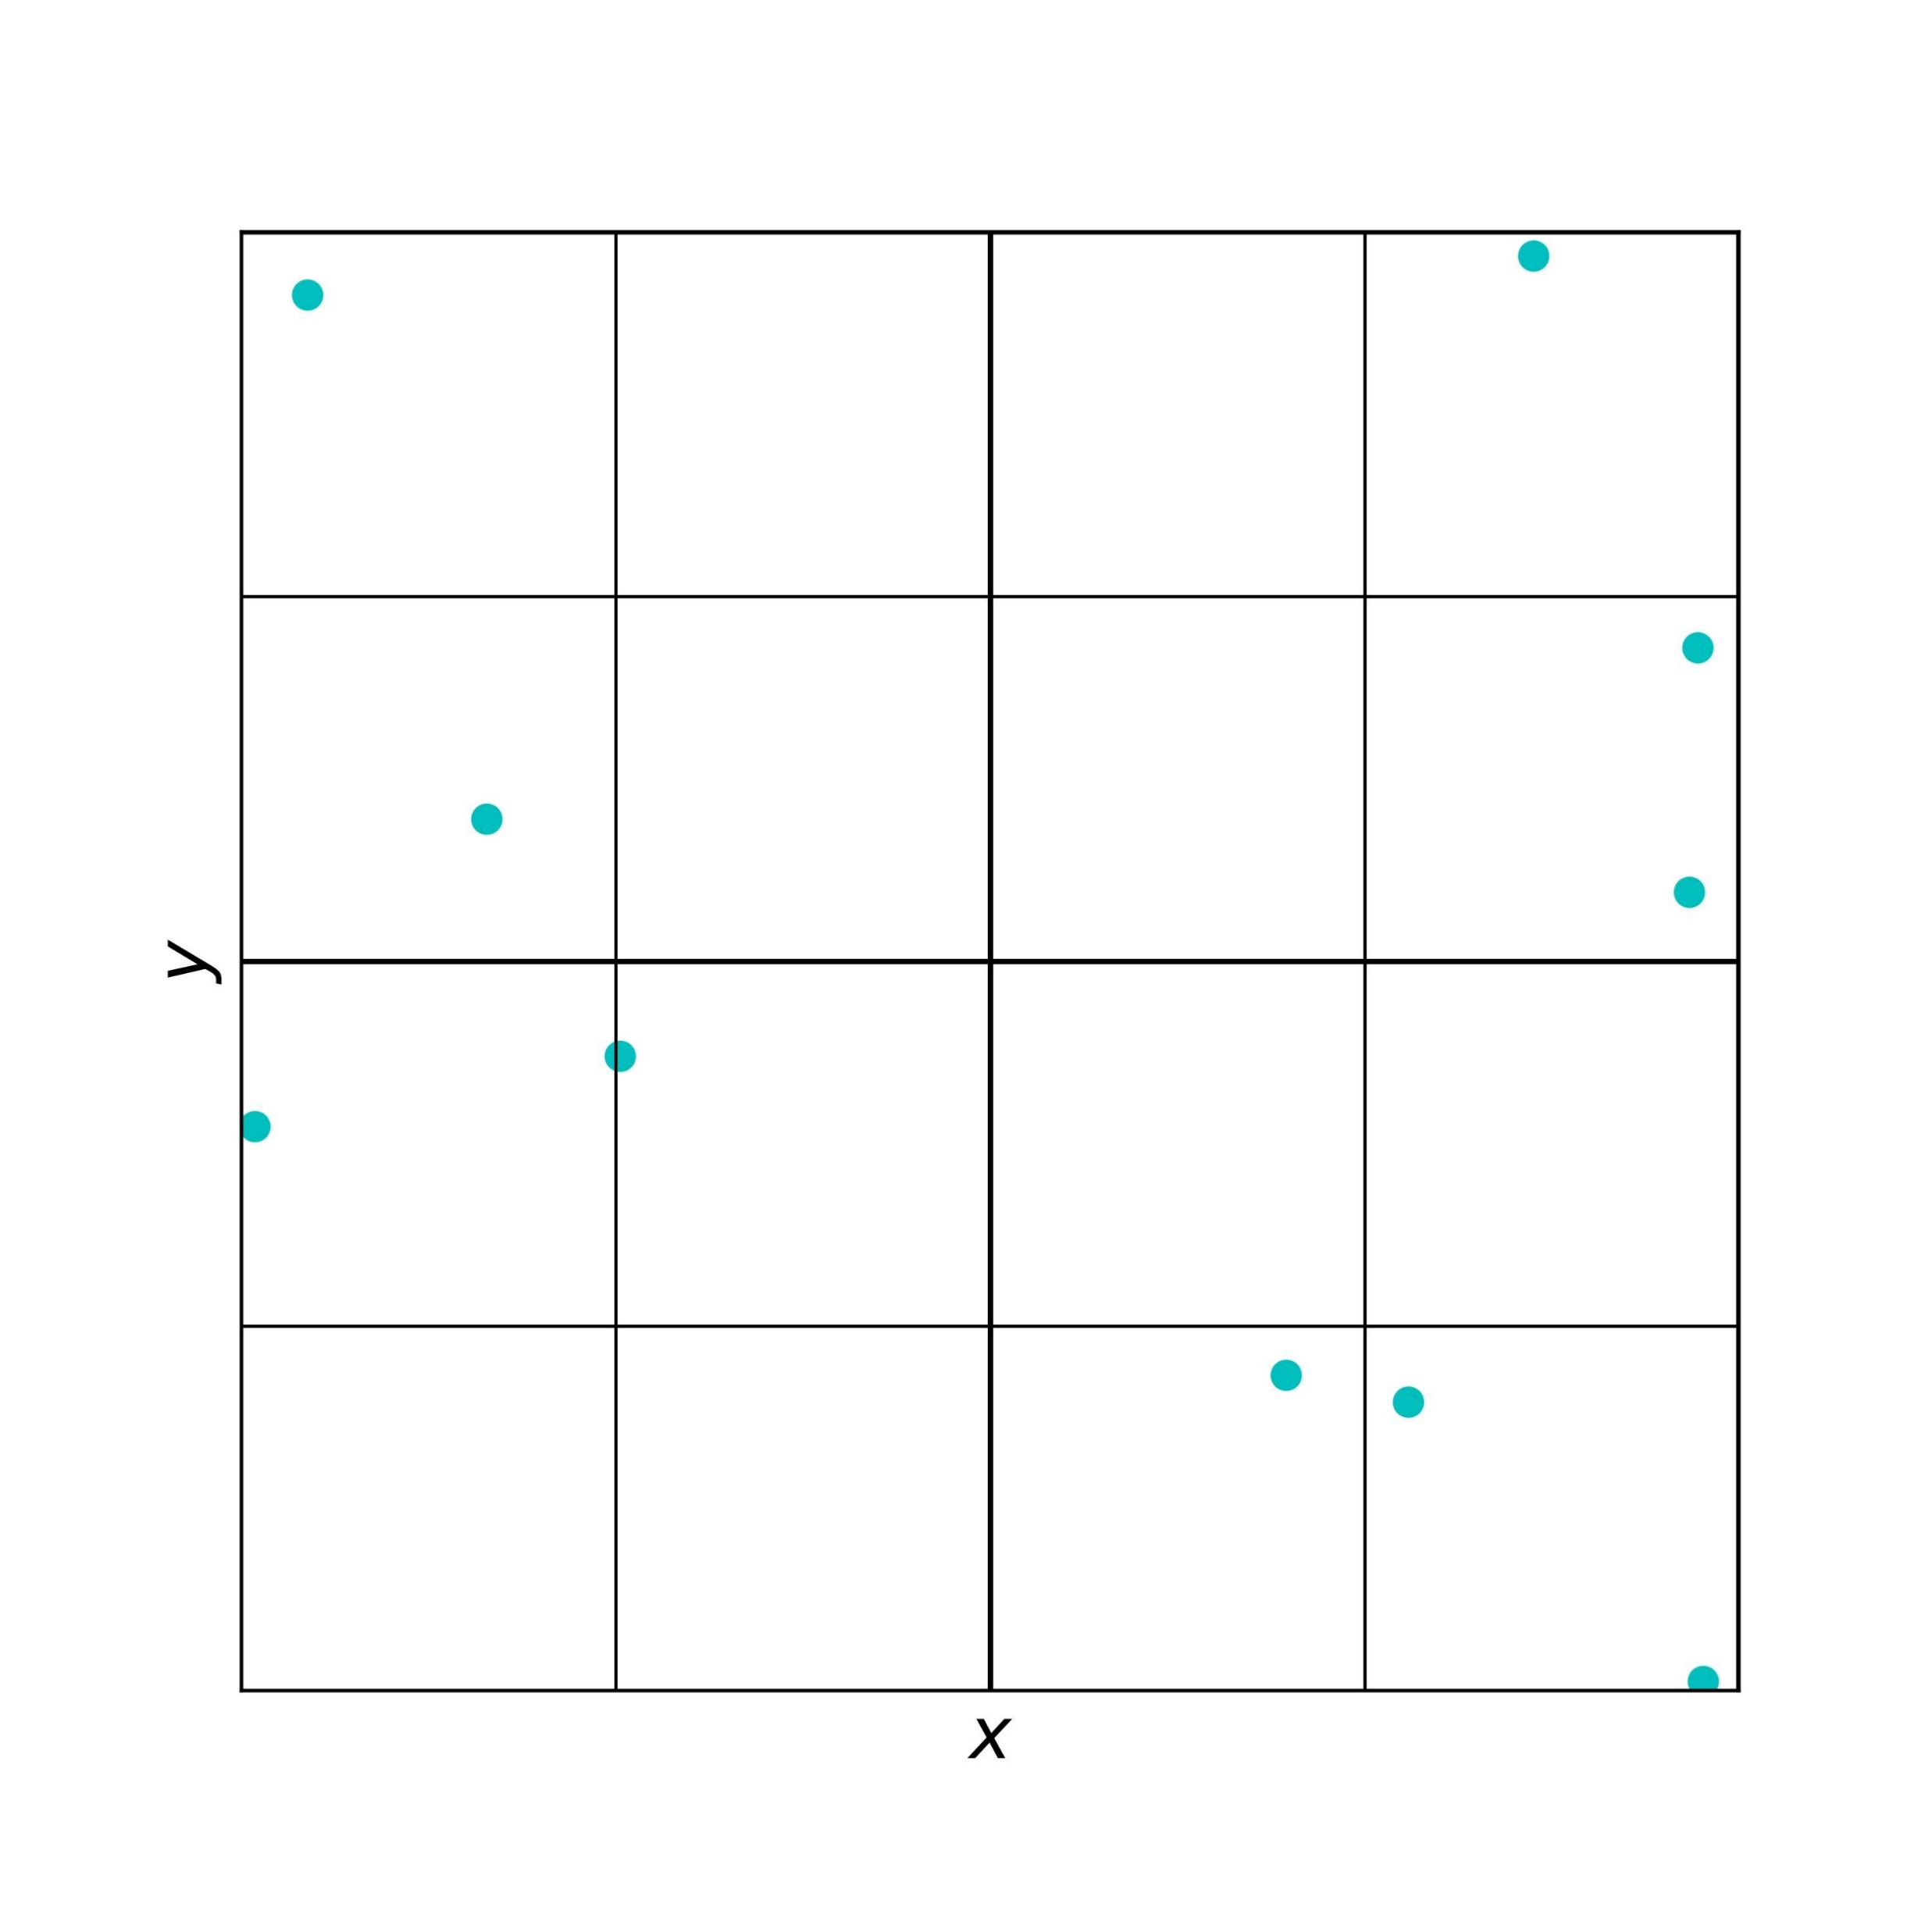
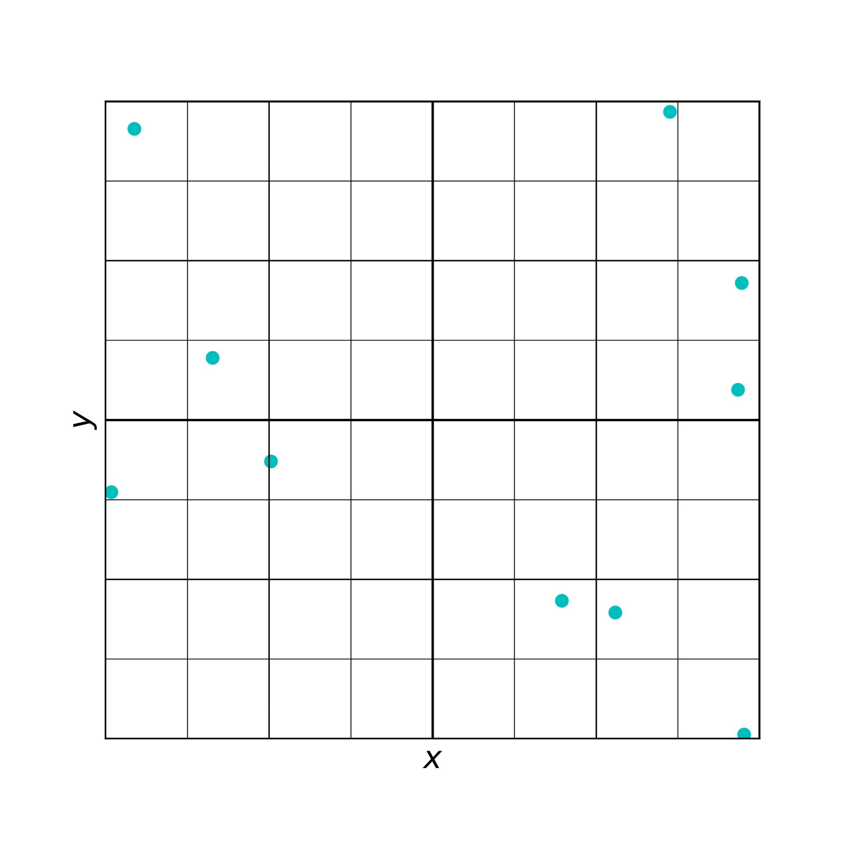


Slide 12
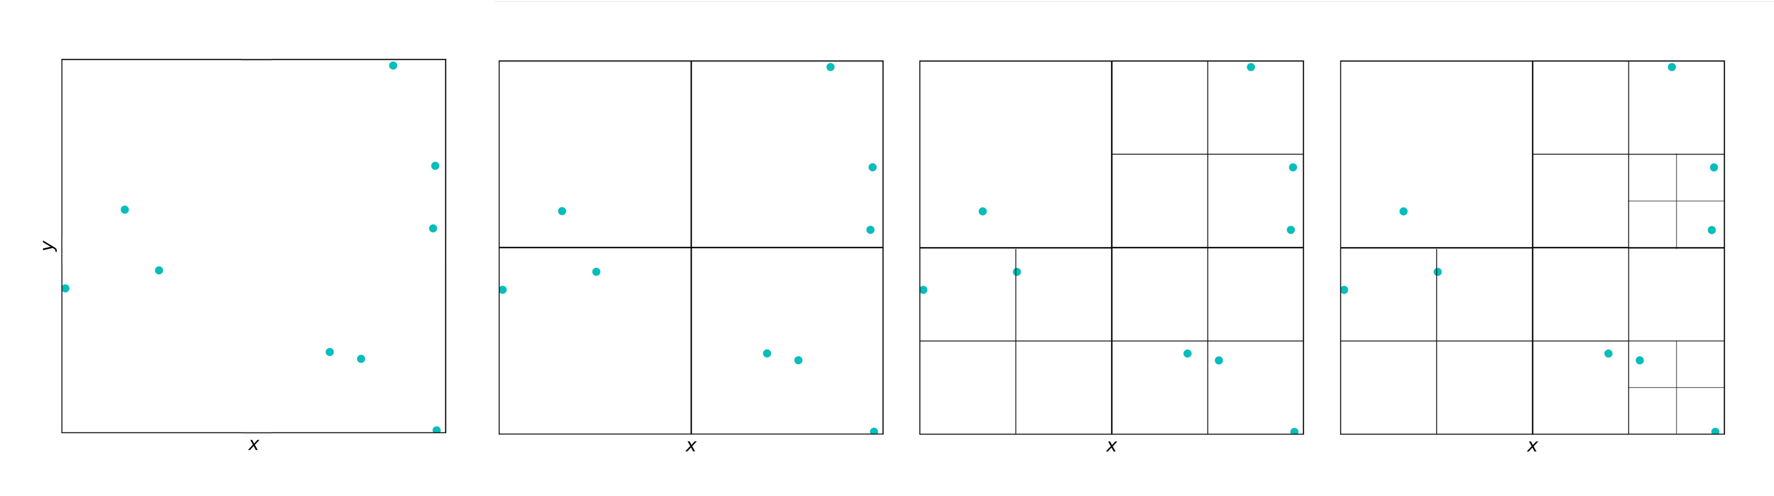
043
044
03
04
041
042
0423
0424
0421
0422
0
013
014
023
024
01
02
011
012
021
022
0223
0224
0220
0221
Ddwdww
Level
0
1
2
3
Higher level (finer division)

Slide 13
Ddwdww
s
s
s
043
044
s
03
04
✓
041
042
0423
0424
R
0421
0422
0
x
target
x
013
014
023
024
01
02
x
0223
0224
011
012
021
022
✓
0220
0221
Level
0
1
2
3
s
θ=1/2
R₁
s/R₁ < θ (source group far enough from target, can approximate as point mass)
R₂
✓
s/R₂ > θ (source group close to target, go to a finer level)
x

Slide 14
Ddwdww
s
s
s
043
044
s
03
04
leaf
✓
041
042
0423
0424
R
0421
0422
0
x
leaf
x
013
014
023
024
01
02
leaf
x
0223
0224
011
012
021
022
✓
0220
0221
Level
0
1
2
3
s
θ=1/2
R₁
s/R₁ < θ (source group far enough from target, can approximate as point mass)
R₂
✓
s/R₂ > θ (source group close to target, go to a finer level)
x

Slide 15


N sources
M targets
Direct calculation
M × N
Source representation
M + N
Target representation
M + N
Source and target representation
M + N

Slide 16
s sources
Direct calculation: gst
s sources
t targets
Source representation: g (s + t)
g source groups
(each with s particles)
×
.
.
.
Source and target representation: gs + t
s sources
×
: target expansion centre

Slide 17
0
leaf box
01
02
03
04
011
012
013
014
021
022
023
024
041
042
043
044
0220
0221
0223
0224
0420
0421
043
044

Slide 20
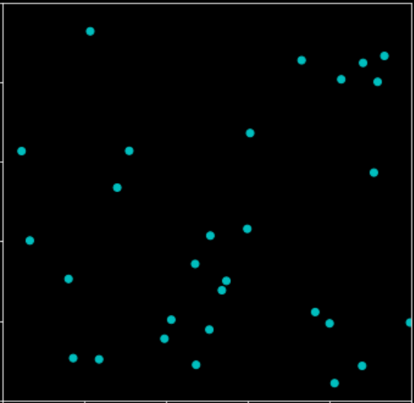
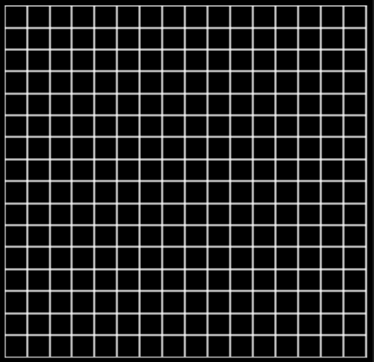





Slide 21







Slide 22



Slide 23



Slide 24


Slide 27

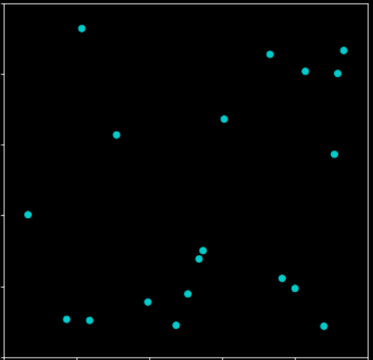

Slide 28
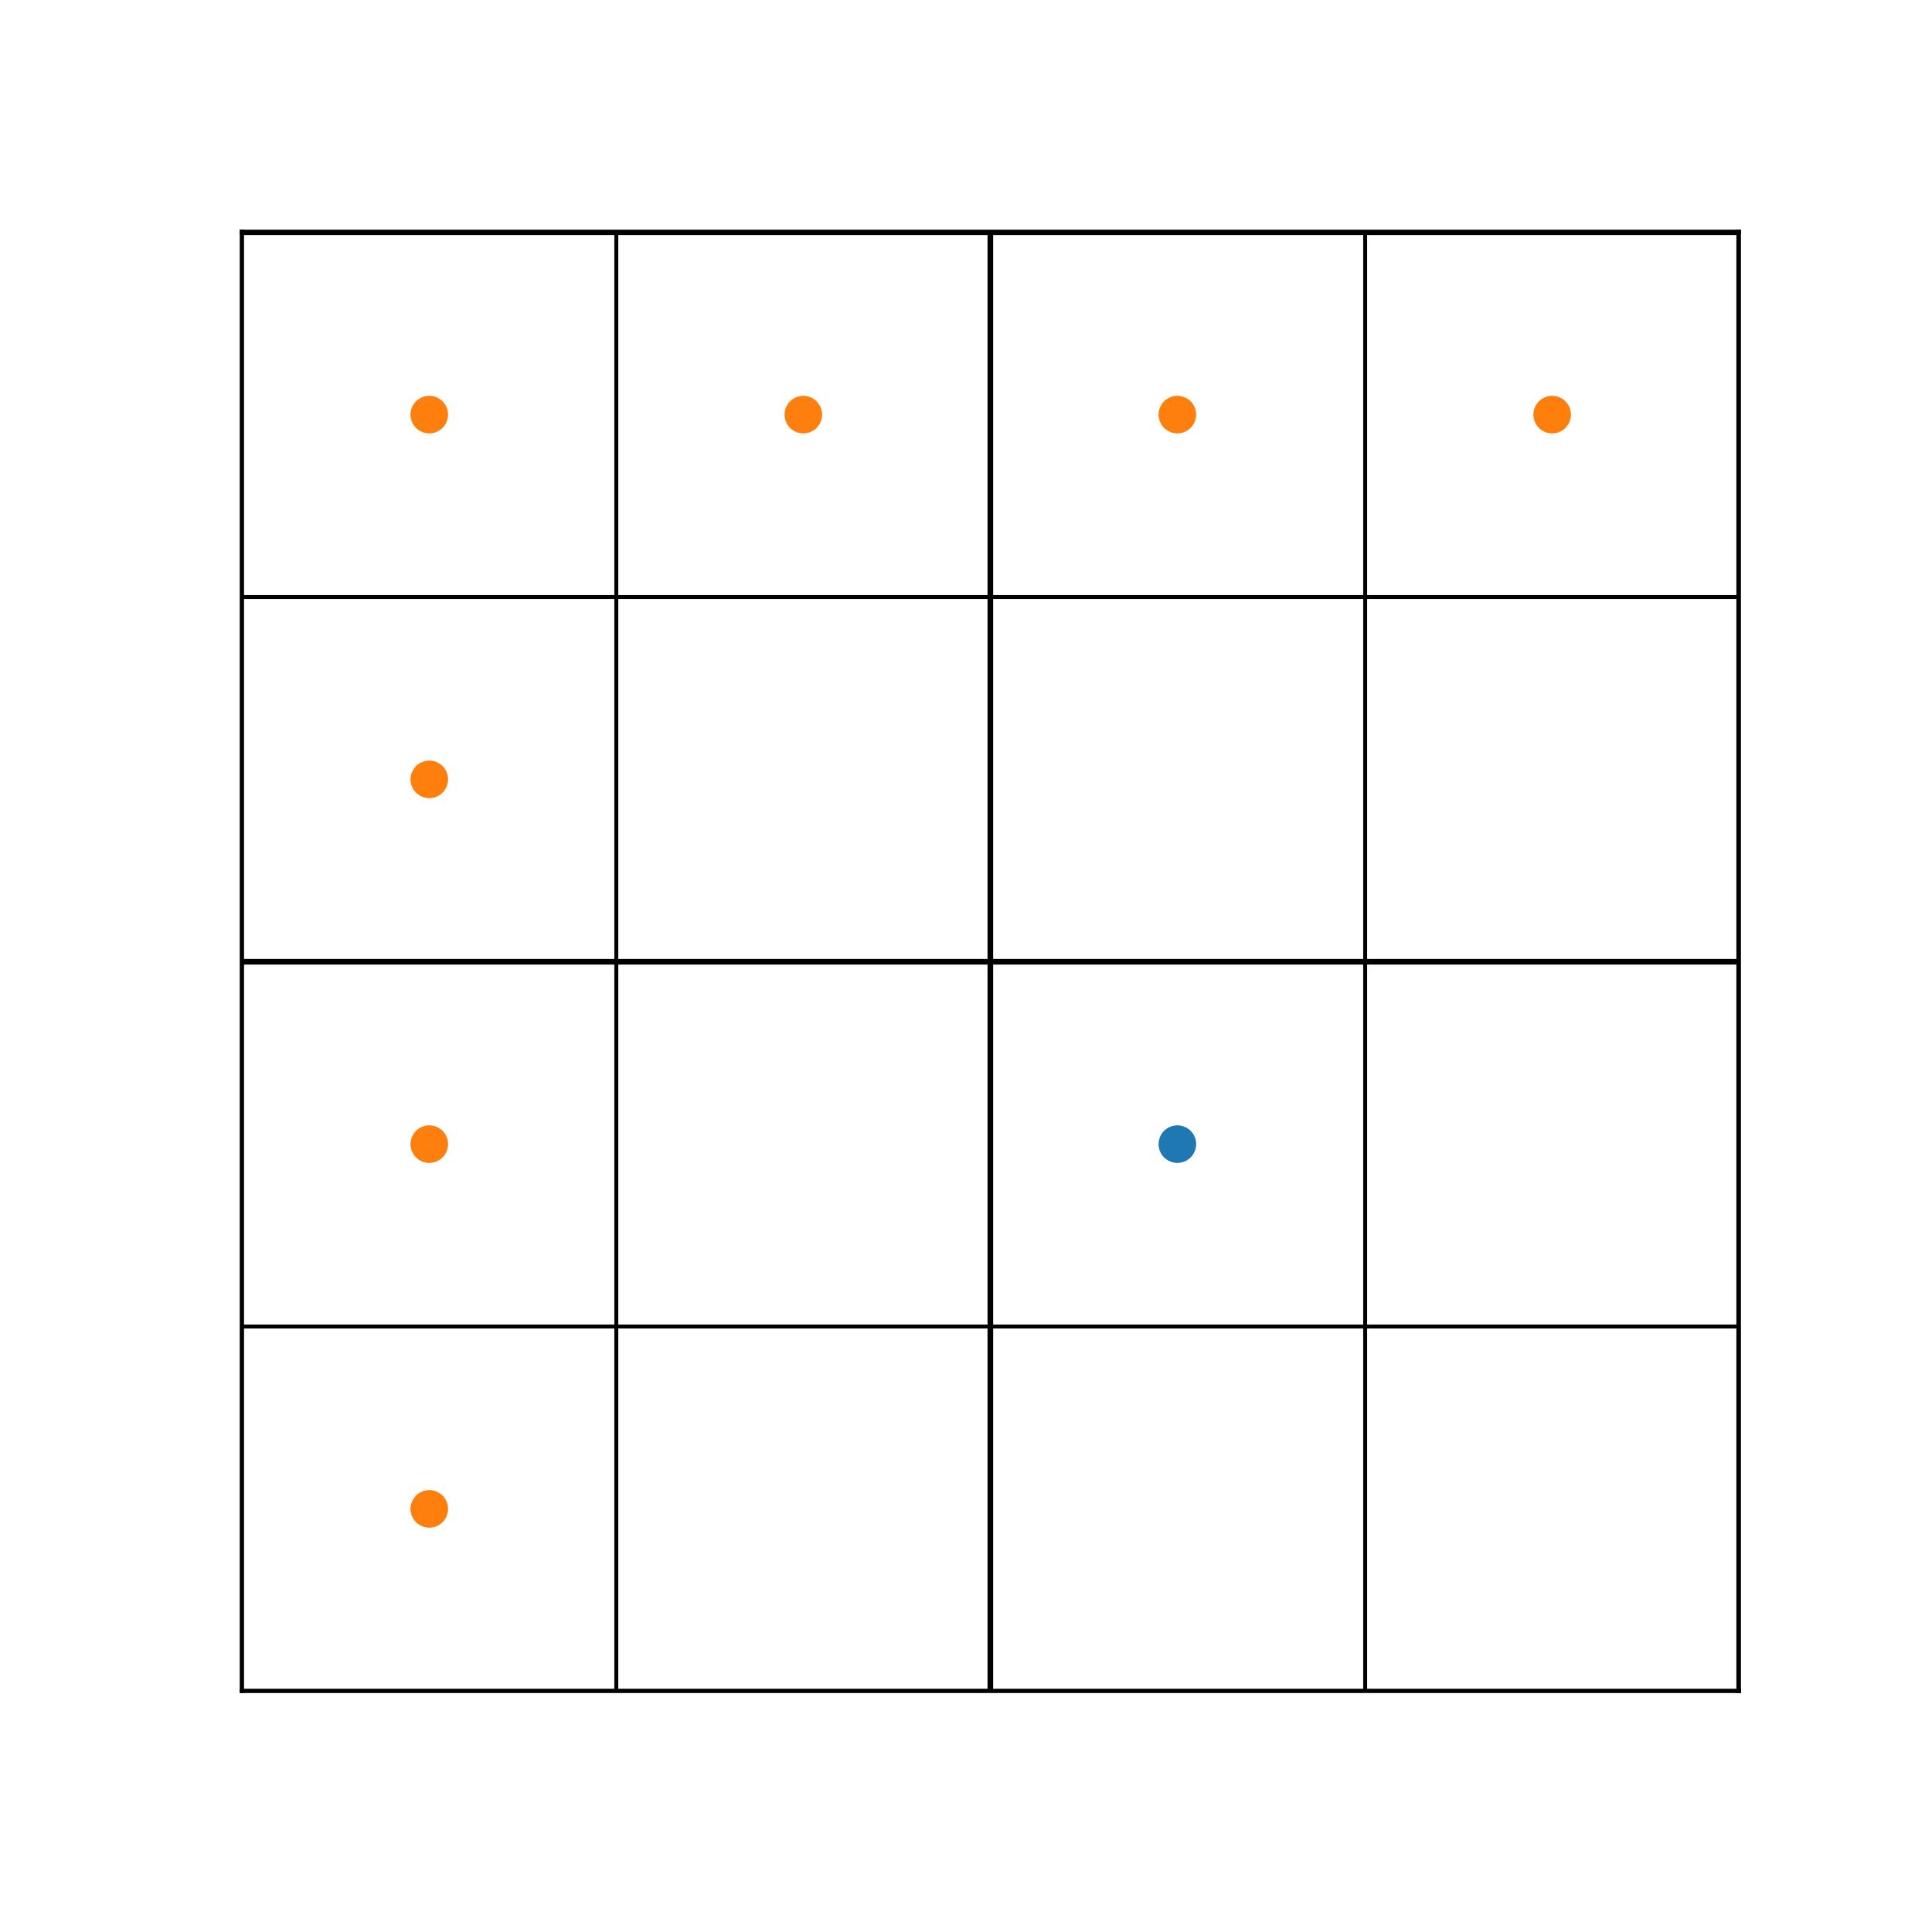

Slide 29

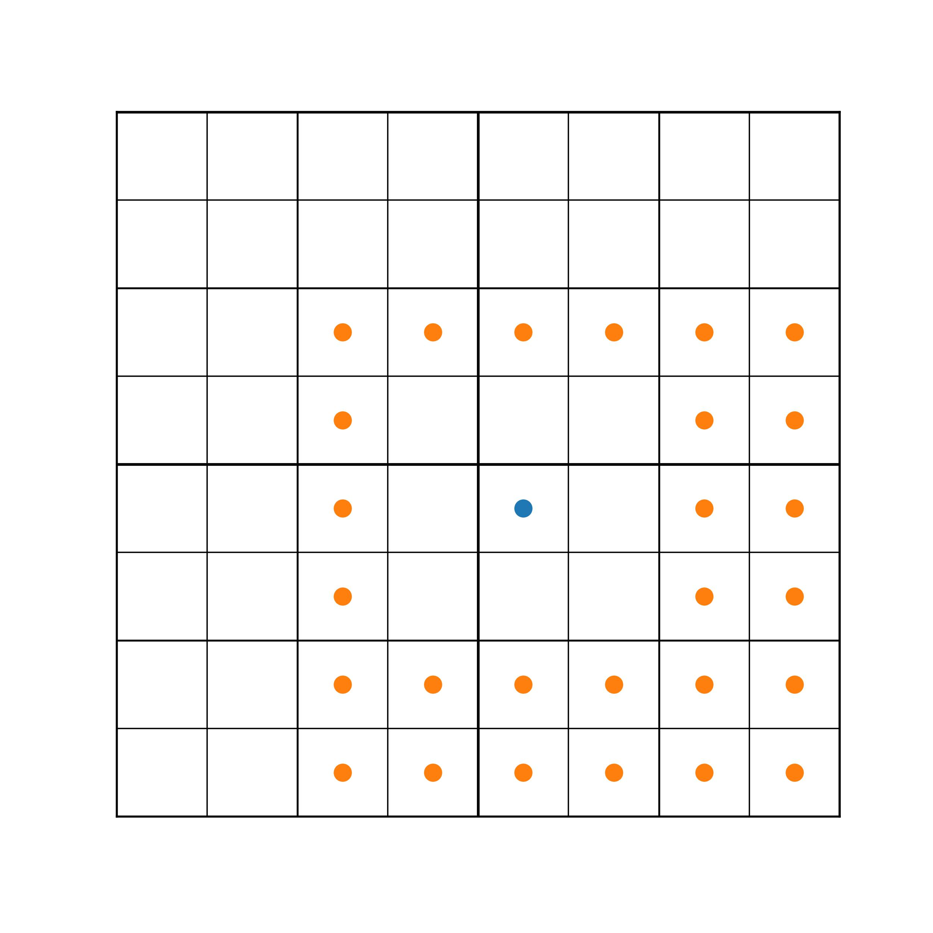
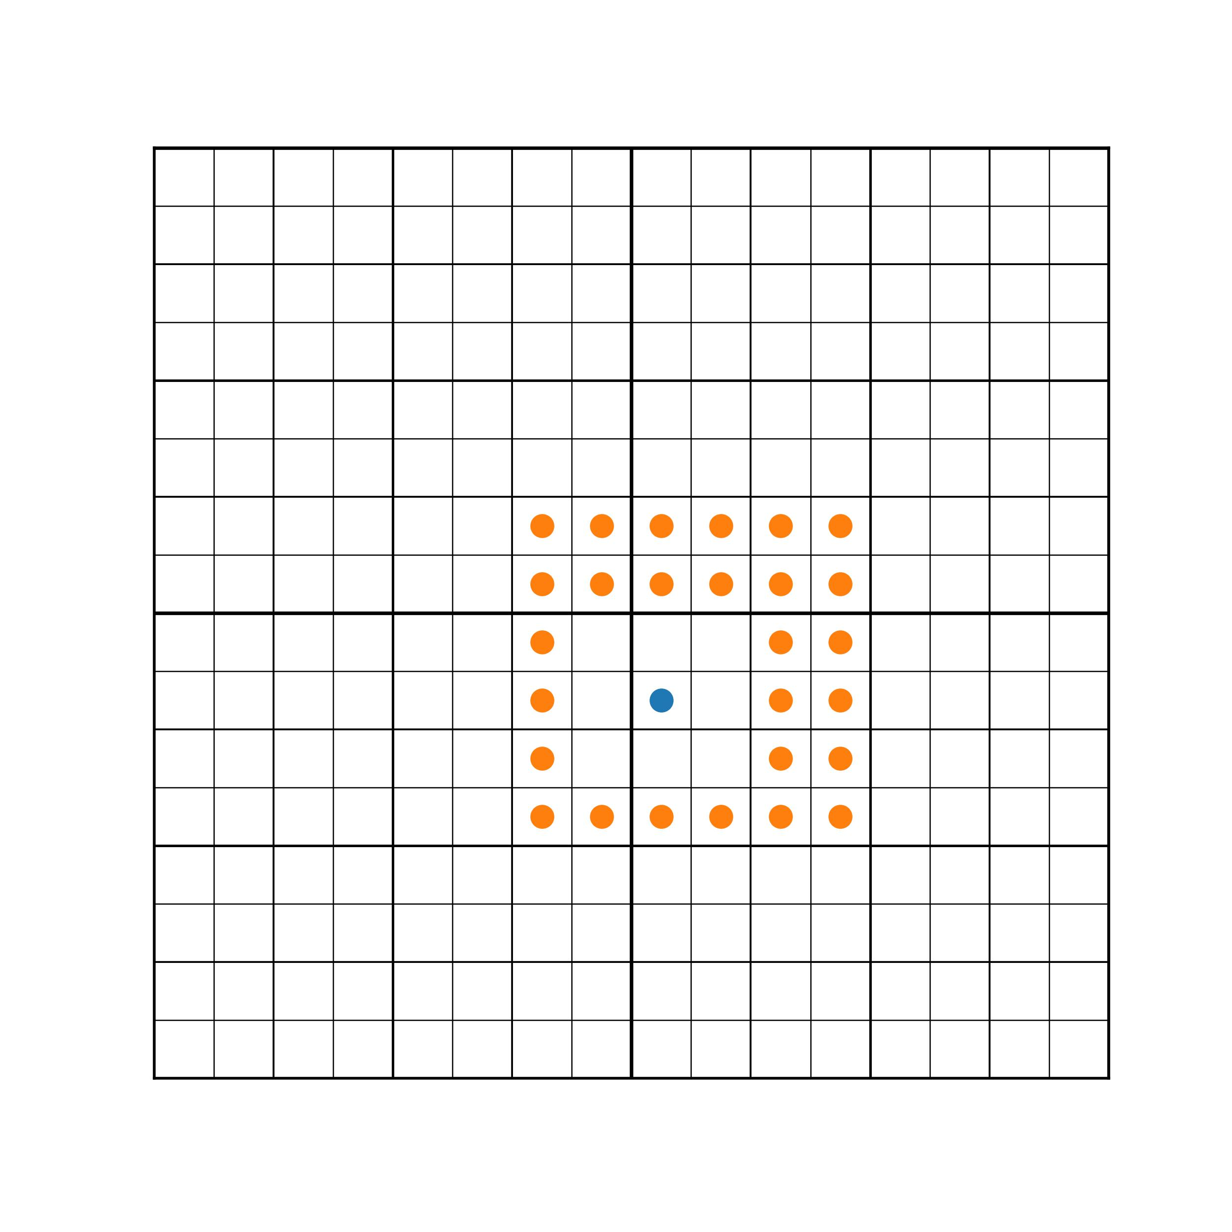
Interaction list
Target box

Slide 32
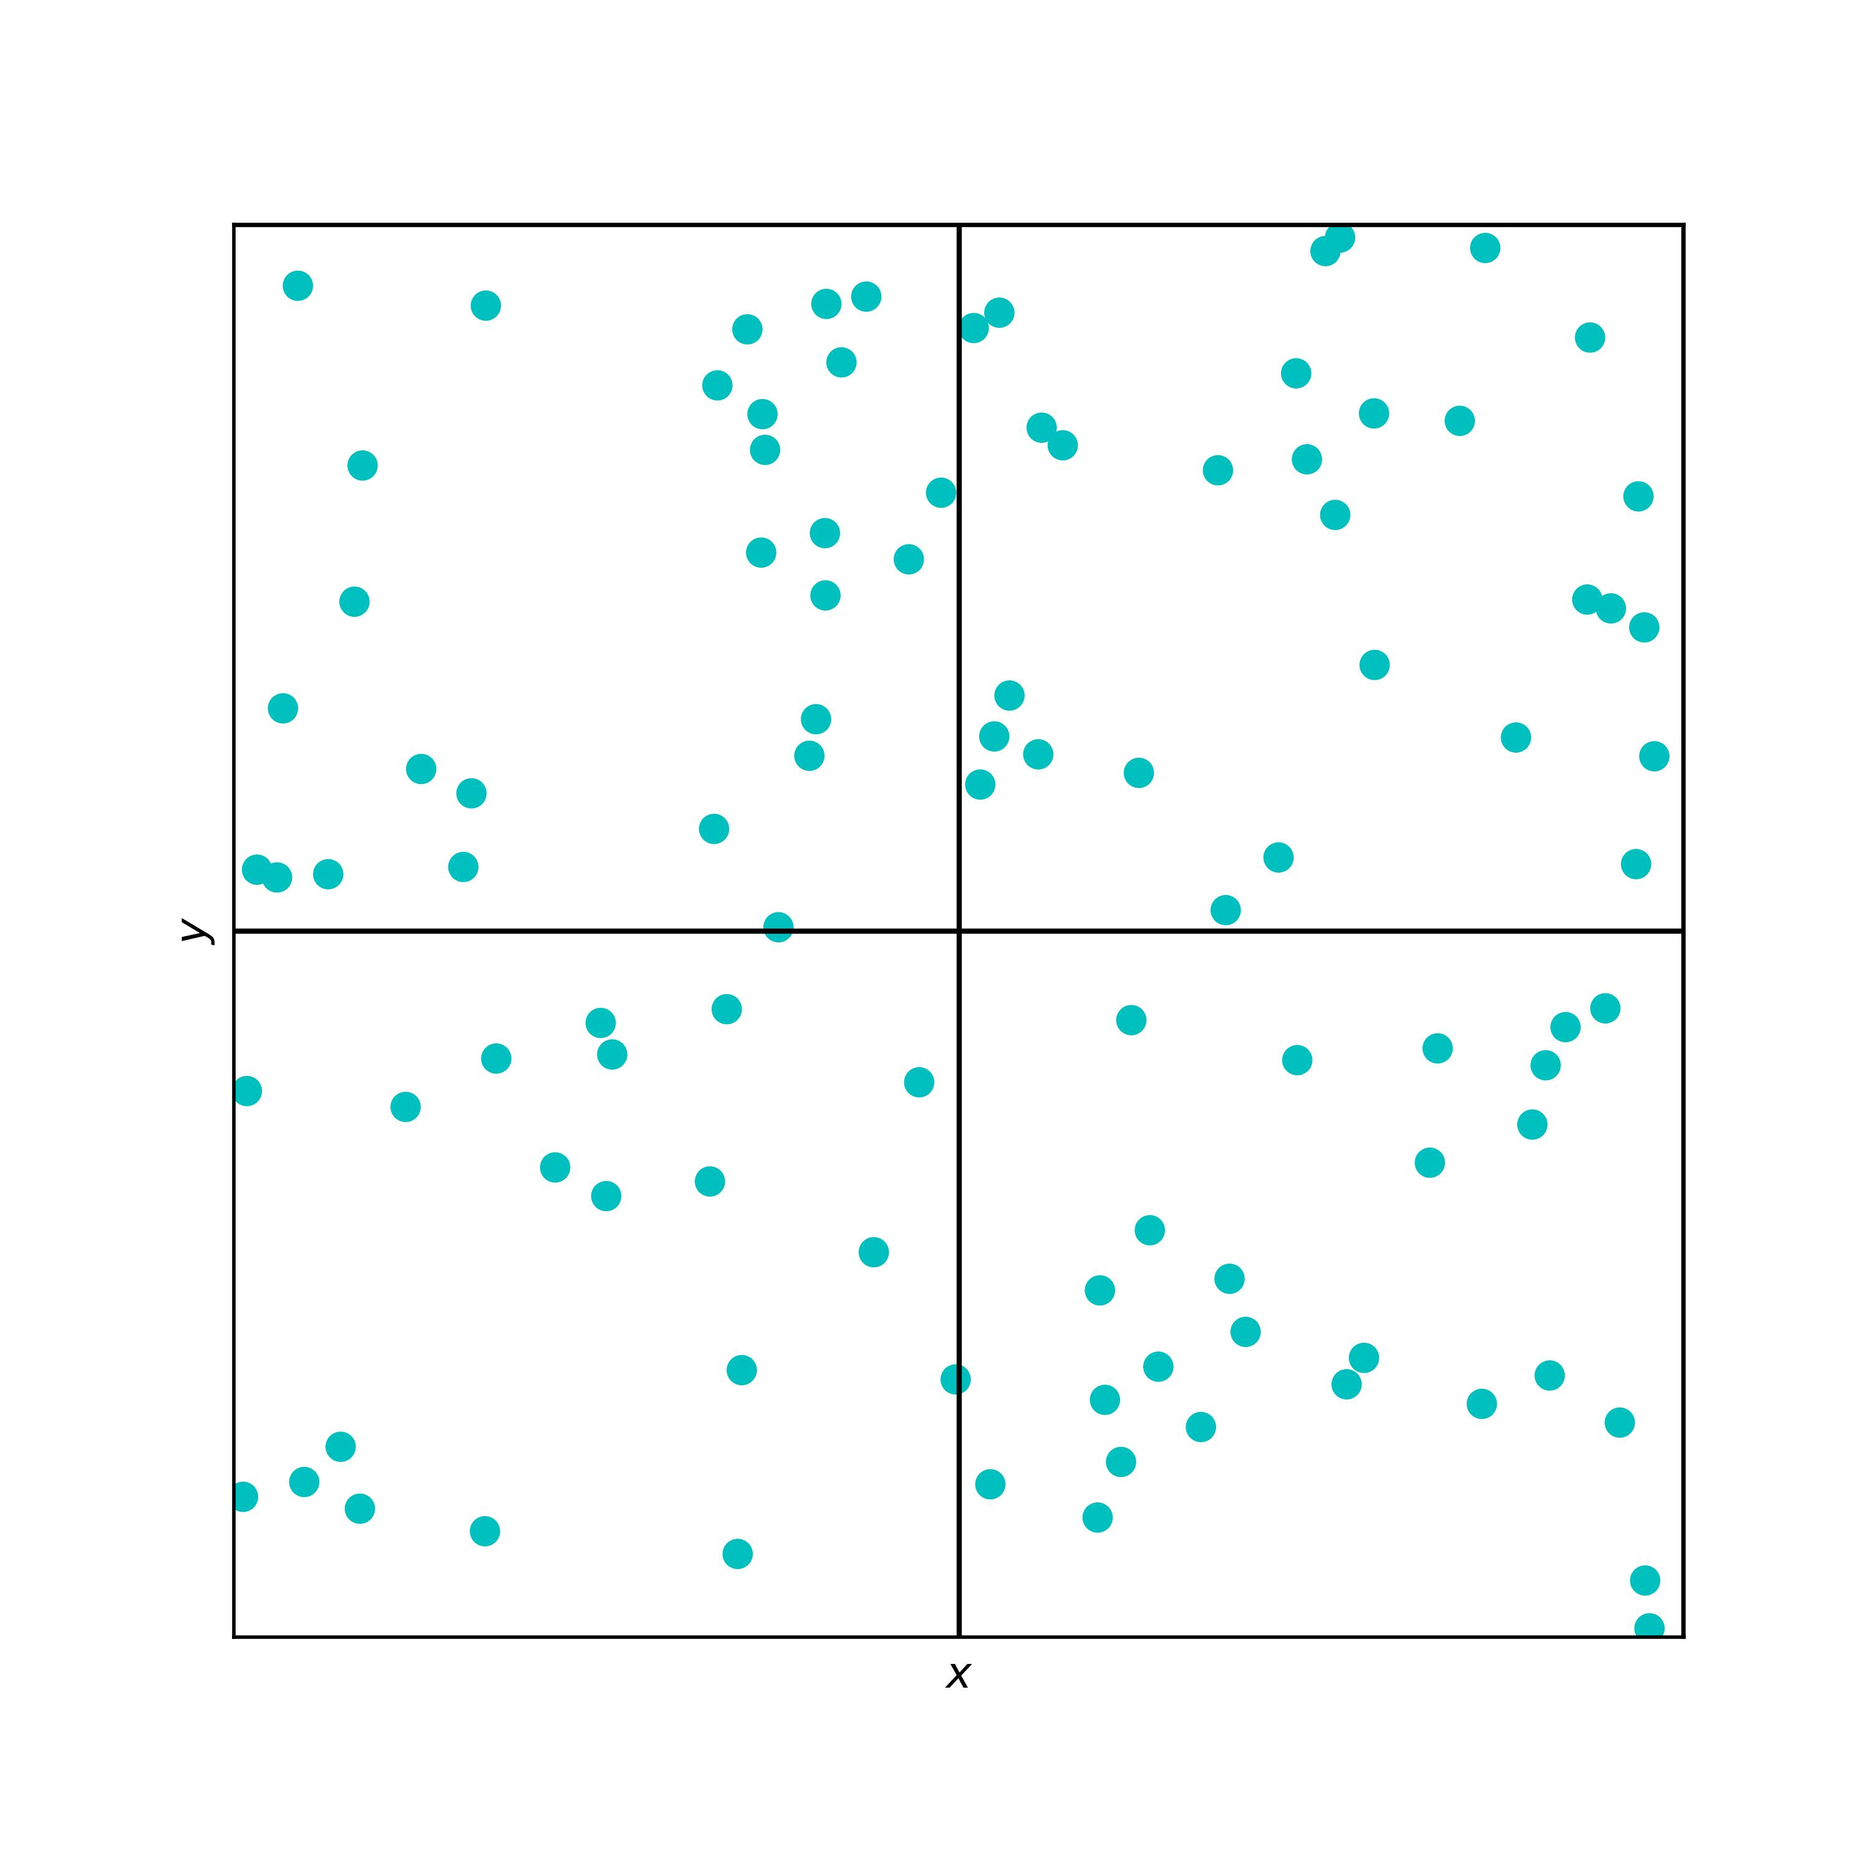
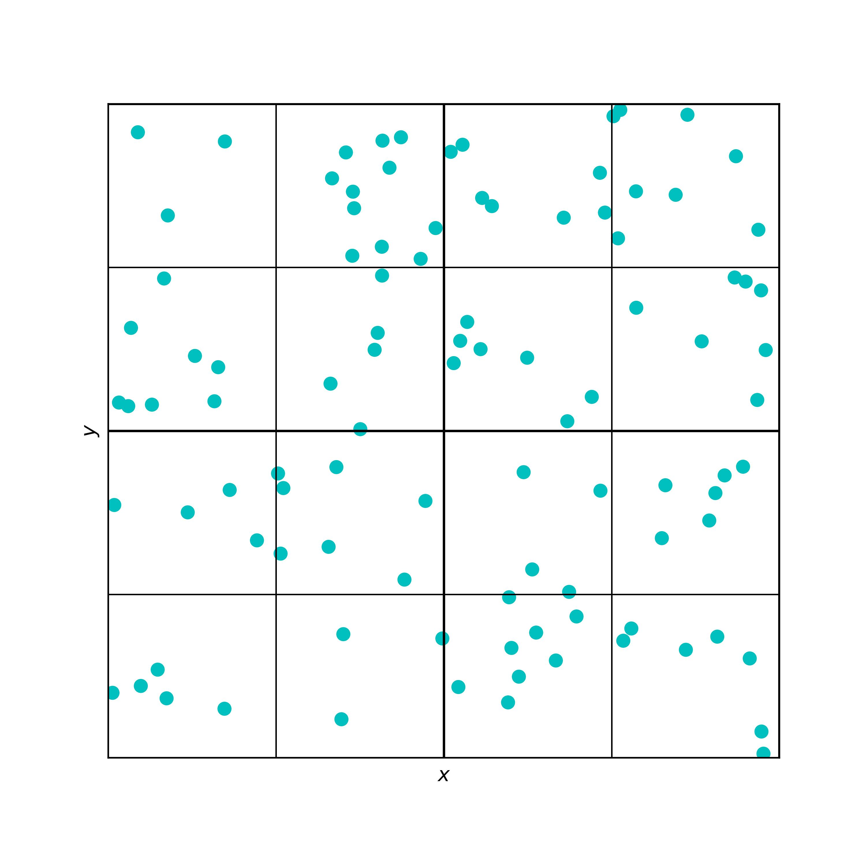
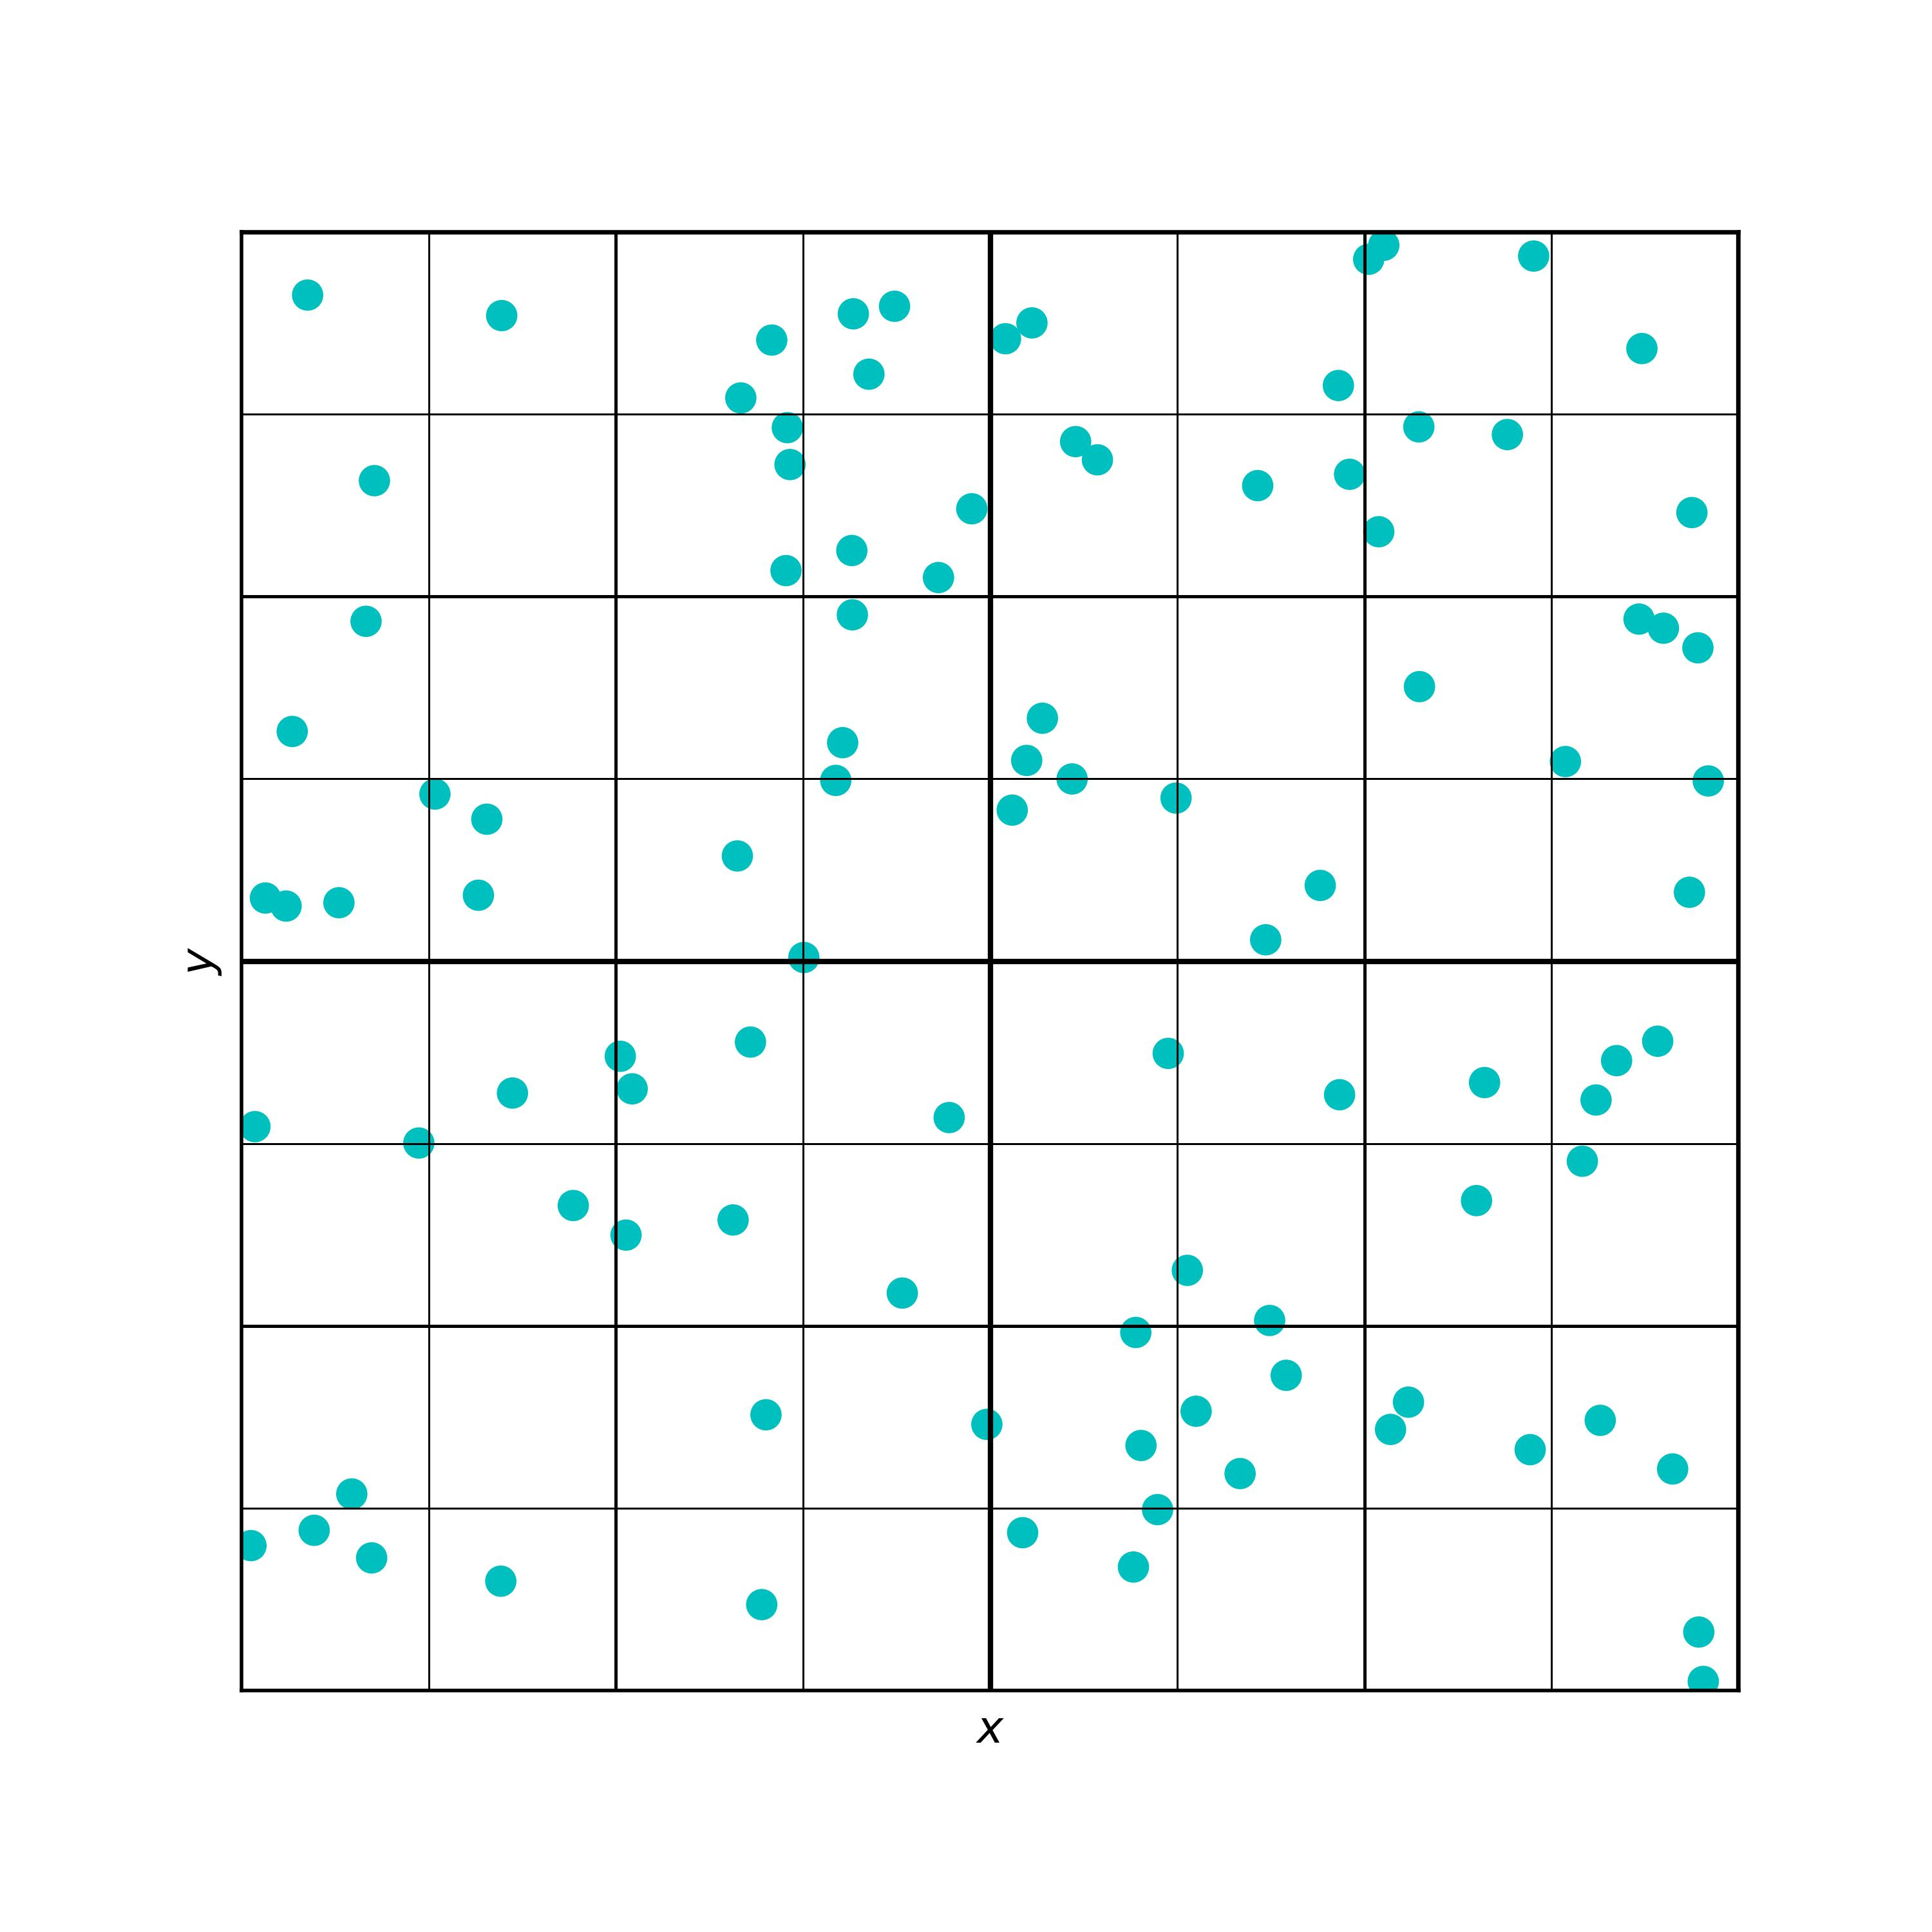
✓
✓
✓
✓
✓
✓
✓
✓
✓
✓
✓
✓
✓
✓
✓
✓
target
target
✓
✓
target
✓
✓
✓
✓
✓
✓
✓
✓
✓
✓
✓
✓
✓
✓
✓
✓
✓
✓
✓
✓
✓
✓

Slide 33
✓
✓
✓
✓
✓
✓
✓
✓
✓
✓
✓
✓
✓
✓
✓
✓
✓
✓
✓
✓
✓
✓
✓
✓
✓
✓
✓
✓
✓
✓
target
target
target

